Slide 1
Distributed Databases [Database Distribution Strategies]

Slide 2
1. Centralized Database:
A centralized database is basically a type of database that is stored, located as well as maintained at a single location only. This type of database is modified and managed from that location itself. This location is thus mainly any database system or a centralized computer system. The centralized location is accessed via an internet connection (LAN, WAN, etc). This centralized database is mainly used by institutions or organizations.
Advantages:
Since all data is stored at a single location only thus it is easier to access and coordinate data.
The centralized database has very minimal data redundancy since all data is stored in a single place.
It is cheaper in comparison to all other databases available.
Disadvantages:
The data traffic in the case of a centralized database is more.
If any kind of system failure occurs in the centralized system then the entire data will be destroyed.

Slide 3
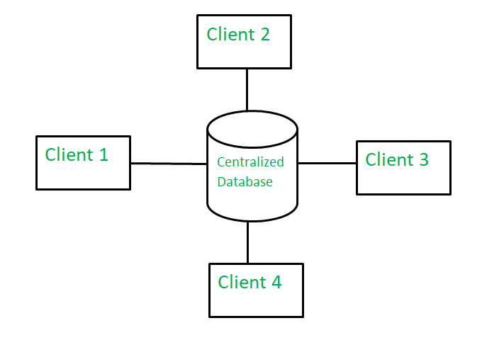

Slide 4
2. Distributed Database:
A distributed database is basically a type of database which consists of multiple databases that are connected with each other and are spread across different physical locations. The data that is stored in various physical locations can thus be managed independently of other physical locations. The communication between databases at different physical locations is thus done by a computer network.
Advantages:
This database can be easily expanded as data is already spread across different physical locations.
The distributed database can easily be accessed from different networks.
This database is more secure in comparison to a centralized database.
Disadvantages:
This database is very costly and is difficult to maintain because of its complexity.
In this database, it is difficult to provide a uniform view to users since it is spread across different physical locations.

Slide 5
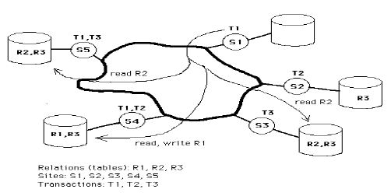

Slide 6
S.NO. | Basis of Comparison | Centralized database | Distributed database
1. | Definition | It is a database that is stored, located as well as maintained at a single location only. | It is a database that consists of multiple databases which are connected with each other and are spread across different physical locations.
2. | Access time | The data access time in the case of multiple users is more in a centralized database. | The data access time in the case of multiple users is less in a distributed database.
3. | Management of data | The management, modification, and backup of this database are easier as the entire data is present at the same location. | The management, modification, and backup of this database are very difficult as it is spread across different physical locations.

Slide 7
4. | View | This database provides a uniform and complete view to the user. | Since it is spread across different locations thus it is difficult to provide a uniform view to the user.
5. | Data Consistency | This database has more data consistency in comparison to distributed database. | This database may have some data replications thus data consistency is less.
6. | Failure | The users cannot access the database in case of database failure occurs. | In a distributed database, if one database fails users have access to other databases.
7. | Cost | A centralized database is less costly. | This database is very expensive.

Slide 8
8. | Maintenance | Ease of maintenance because the whole of the data and information is available at a single location and thus, easy to reach and access. | It is difficult to maintain because of the distribution of data and information at varied places. So, there is a need to check for data redundancy issues and how to maintain data consistency.
9. | Efficient | A centralized database is less efficient as data finding becomes quite complex because of the storing of data and information at a particular place. | A distributed database is more efficient than a centralized database because of the splitting up of data at several places which makes data finding simple and less time-consuming.

Slide 9
10. | Response Speed | The response speed is more in comparison to a distributed database. | The response speed is less in comparison to a centralized database.
11. | Advantages | Integrity of data Security Easy access to all information Data is easily portable | High performance because of the division of workload. High availability because of the readiness of available nodes to do work. Independent nodes and better control over resources

Slide 10
12. | Disadvantages | Data searching takes time In case of failure of a centralized server, the whole database will be lost. If multiple users try to access the data at the same time then it may create issues. | It is quite large and complex so difficult to use and maintain. Difficult to provide security Issue of data integrity Increase in storage and infrastructure requirements Handling failures is a quite difficult task
13. | Examples | A desktop or server CPU A mainframe computer. | Apache Ignite Apache Cassandra Apache HBase Amazon SimpleDB Clusterpoint FoundationDB.

Slide 11
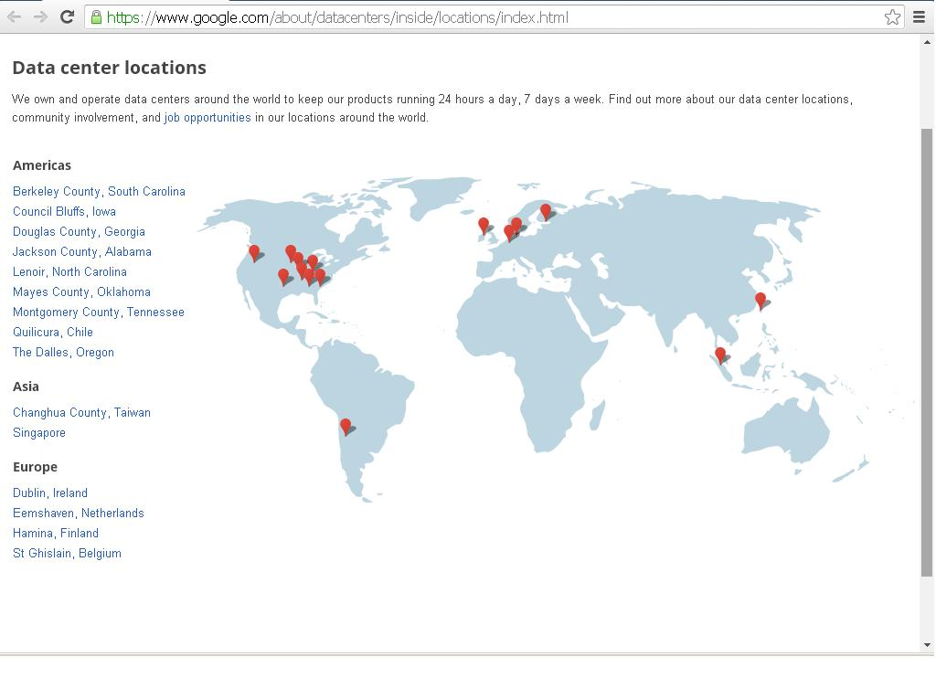

Slide 12
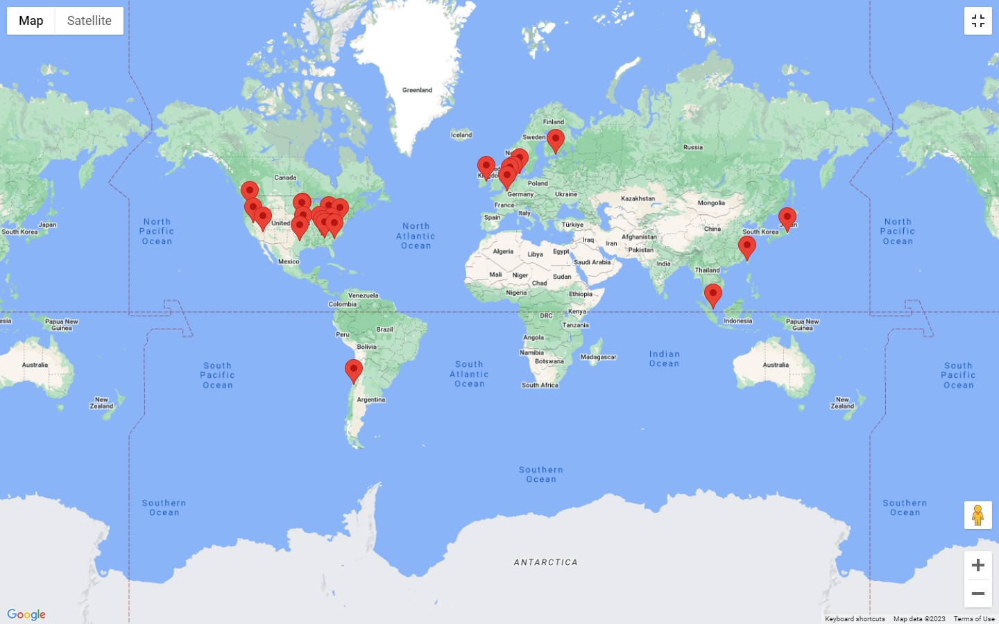

Slide 13
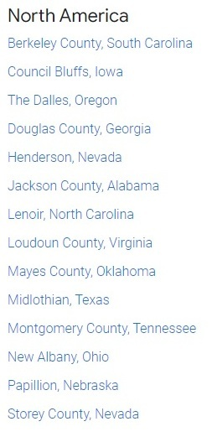
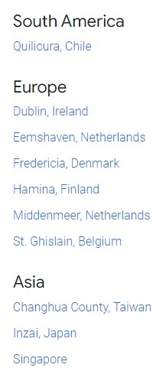

Slide 14


Slide 15


Slide 16
https://datacenters.atmeta.com/all-locations/

Slide 17
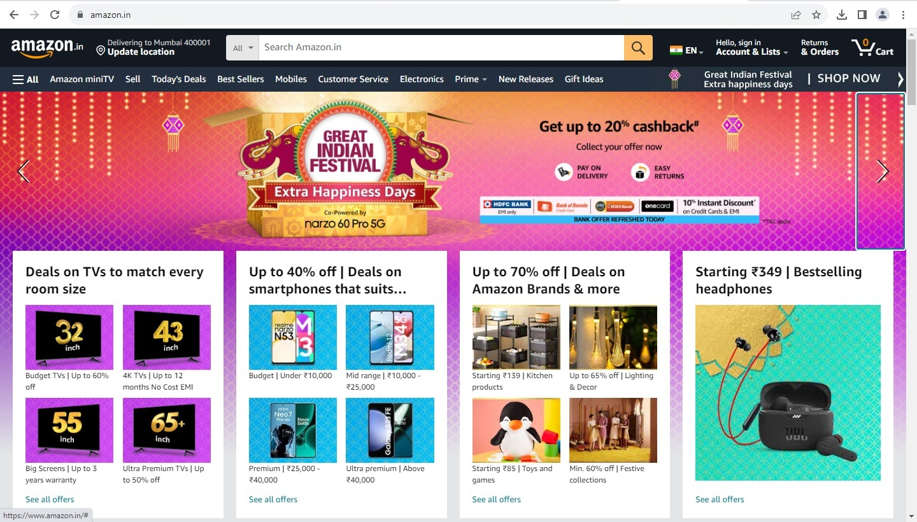

Slide 18


Slide 19
Overview of Distributed Databases
Distributed database - a collection of multiple, logically interrelated databases distributed over a computer network.
Distributed Database Management System (DDBMS) - a software system that permits the management of a distributed database and makes the distribution transparent to the users. If heterogeneous, it may allow transparent simultaneous access to data on multiple dissimilar systems.

Slide 20
A homogeneous distributed database has identical software and hardware running all databases instances, and may appear through a single interface as if it were a single database.
A heterogeneous distributed database may have different hardware, operating systems, database management systems, and even data models for different databases.

Slide 21
Advantages
Improves performance, e.g. it saves communication costs and reduces query delays by providing data at the sites where it is most frequently accessed.
Improves the reliability and availability of a system by providing alternate sites from where the information can be accessed.
Increases the capacity of a system by increasing the number of sites where the data can be located.
Allows users to exercise control over their own data while allowing others to share some of the data from other sites.
Helps solve more complex database problems.

Slide 22
Disadvantages
Increases the complexity of the system and introduces several technical as well as management challenges especially when geographical and organizational boundaries are crossed.
Makes central control more difficult and raises several security issues because a data item stored at a remote site can be always accessed by the users at the remote site.
Makes performance evaluation difficult because a process running at one node may impact the entire network.

Slide 23
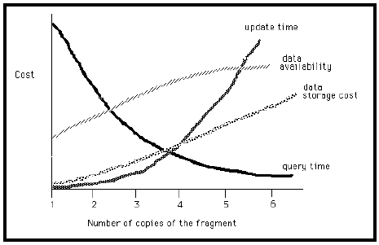

Slide 24
Requirements of a Generalized DDBMS: Date’s 12 Rules
Rule 1. Local Autonomy. Local data is locally owned and managed, even when it is accessible by a remote site. Security, integrity, and storage remain under control of the local system. Local users should not be hampered when their system is part of a distributed system.
Rule 2. No Central Site. There must be no central point of failure or bottleneck. Therefore the following must be distributed: dictionary management, query processing, concurrency control, and recovery control.
Rule 3. Continuous Operation. The system should not require a shutdown to add or remove a node from the network. User applications should not have to change when a new network is added, provided they do not need information from the added node.
Rule 4. Location Independence (or Transparency). A common global user view of the
database should be supported so that users need not know where the data is located. This allows data to be moved for performance considerations or in response to storage constraints without affecting the user applications.

Slide 25
Rule 5. Fragmentation Independence (or Transparency). This allows tables to be split
among several sites, transparent to user applications. For example, we can store New York employee records at the New York site and Boston employees at the Boston site, but allow the user to refer to the separated data as EMPLOYEES, independent of their locations.
Rule 6. Replication Independence (or Transparency). This allows several copies of a table
(or portions thereof) to reside at different nodes. Query performance can be improved since applications can work with a local copy instead of a remote one. Update performance, however, may be degraded due to the additional copies. Availability can improve.
Rule 7. Distributed Query Processing. No central site should perform optimization; but the submitting site, which receives the query from the user, should decide the overall strategy. Other participants perform optimization at their own levels.
Rule 8. Distributed Transaction Processing. The system should process a transaction across multiple databases exactly as if all of the data were local. Each node should be capable of acting as a coordinator for distributed updates, and as a participant in other transactions. Concurrency control must occur at the local level (Rule 2), but there must also be cooperation between individual systems to ensure that a “global deadlock” does not occur.

Slide 26
Rule 9. Hardware Independence. The concept of a single database system must be presented regardless of the underlying hardware used to implement the individual systems.
Rule 10. Operating System Independence. The concept of a single database system must be presented regardless of the underlying operating systems used.
Rule 11. Network Independence. The distributed system must be capable of communicating over a wide variety of networks, often different ones in the same configuration. Standard network protocols must be adhered to.
Rule 12. DBMS Independence (Heterogeneity). The distributed system should be able to be made up of individual sites running different database management systems.

Slide 27
Data distribution (allocation).
To Create a data allocation schema that indicates where each copy of each table is to be stored. The allocation schema defines at which site(s) a table is (or is to be) located. A one-to-one mapping in the allocation schema results in non-redundancy, while a one-to-many mapping defines a redundant distributed database.
Fragmentation.
Fragmentation is the process of taking subsets of rows and/or columns of tables as the smallest unit of data to be sent across the network. Unfortunately, very few commercial systems have implemented this feature, but we include a brief discussion for historical reasons. We could define a fragmentation schema of the database based on dominant applications’ “select” predicates (set of conditions for retrieval specified in a select statement).

Slide 28
Rules for Fragmentation
1. Fragments are formed by the select predicates associated with dominant database transactions. The predicates specify attribute values used in the conjunctive (AND) and disjunctive (OR) form of
select commands, and rows (records) containing the same values form fragments.
2. Fragments must be disjoint and their union must become the whole fragment. Overlapping fragments are too difficult to analyze and implement.
3. The largest fragment is the whole table. The smallest table is a single record. Fragments should be designed to maintain a balance between these extremes. (Why?)

Slide 29
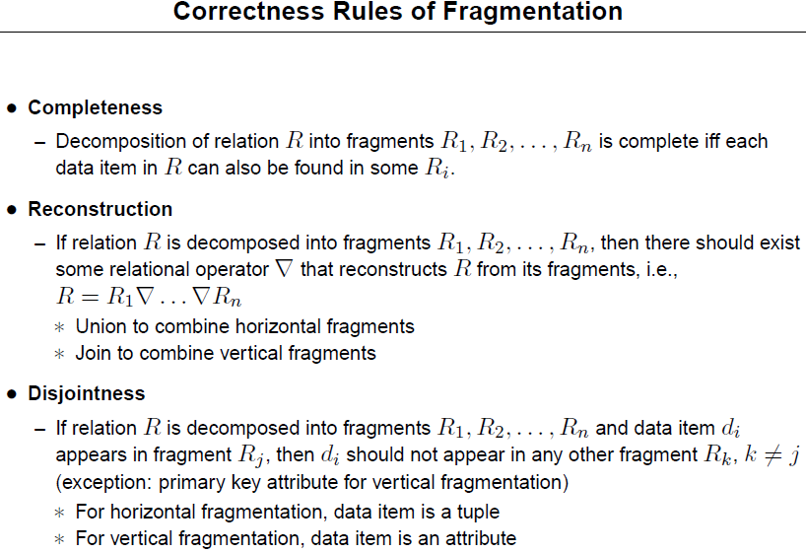

Slide 30
Horizontal fragmentation partitions the rows of a global fragment into subsets. A fragment r1 is a selection on the global fragment r using a predicate Pi, its qualification. The reconstruction of r is obtained by taking the union of all fragments.
Vertical fragmentation subdivides the “attributes” of the global fragment into groups. The simplest form of vertical fragmentation is decomposition. A unique row-id may be included (WHY?) in each fragment to guarantee that the reconstruction through a join operation is possible.
Mixed fragmentation is the result of the successive application of both fragmentation techniques.

Slide 31
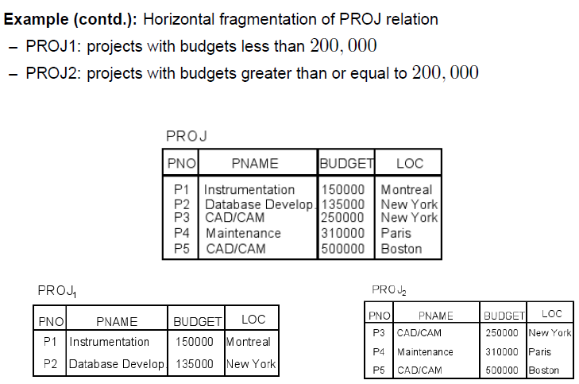

Slide 32
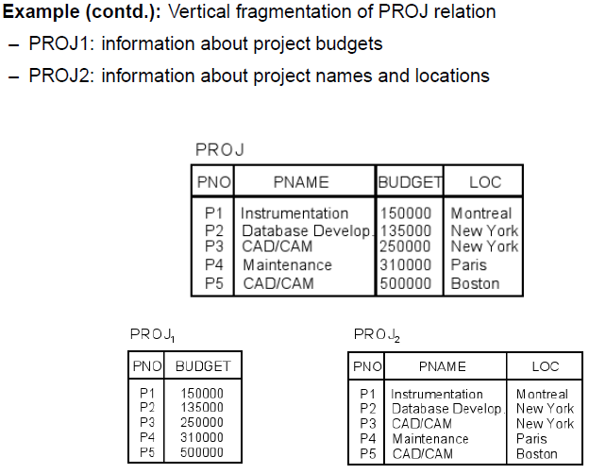

Slide 33
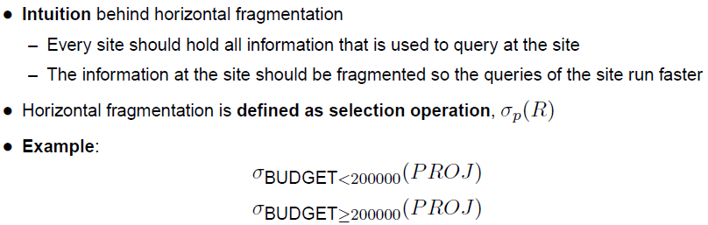
Horizontal Frag Contd

Slide 34
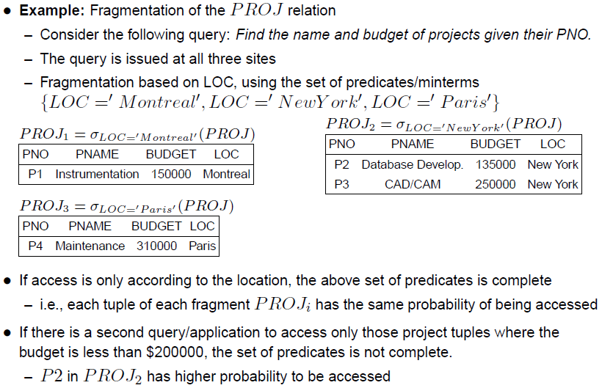

Slide 35
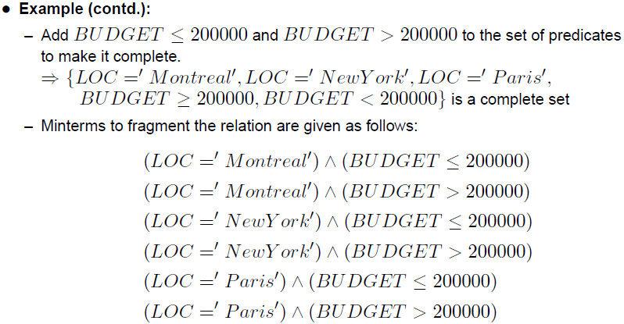

Slide 36
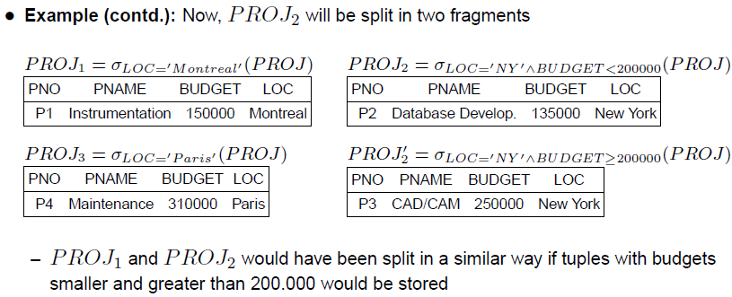
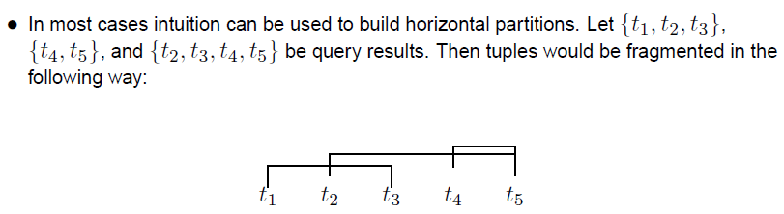

Slide 37
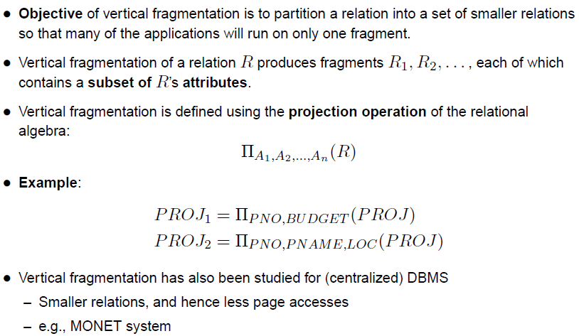
Vertical Fragmentation

Slide 38
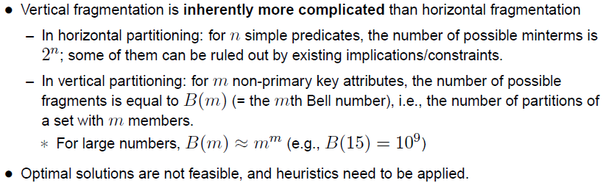

Slide 39
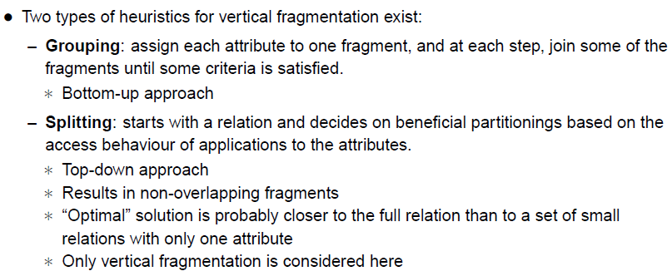
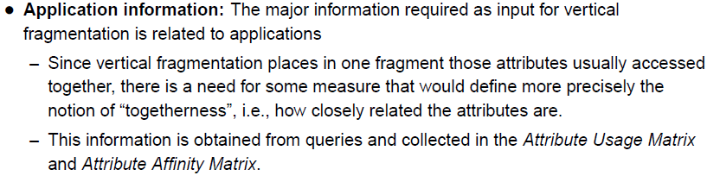
Only If Interested

Slide 40
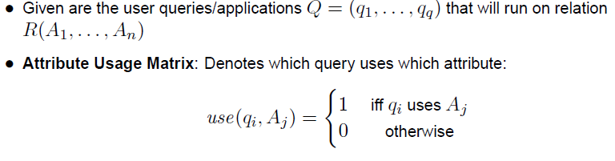
Attribute Usage Matrix

Slide 41
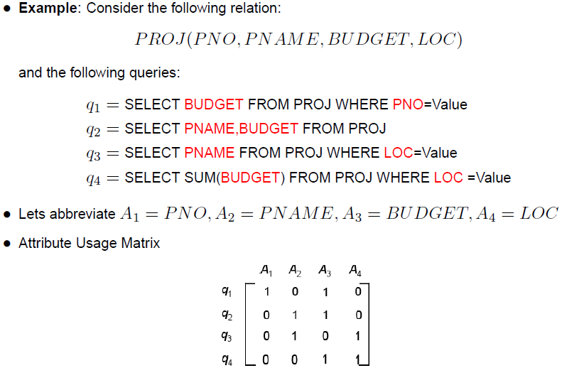

Slide 42
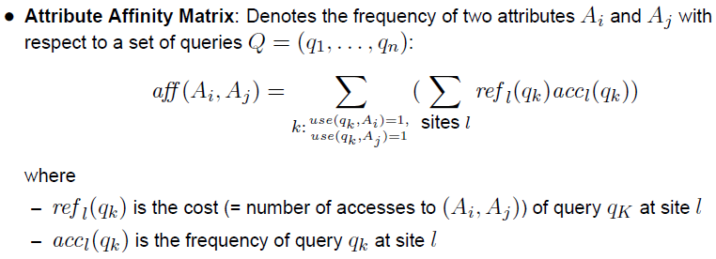
Attribute Affinity Matrix

Slide 43
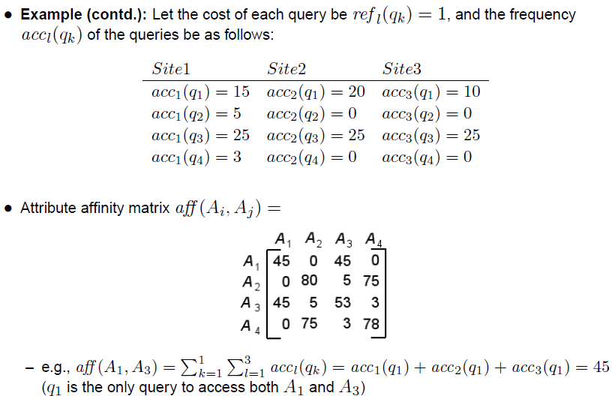

Slide 44
Data Distribution
Data distribution defines the constraints under which data allocation strategies may operate. They are determined by the system architecture and the available network database management software. The four basic data distribution approaches are :
Centralized
In the centralized database approach, all the data are located at a single site. The implementation of this approach is simple. However, the size of the database is limited by the availability of the secondary storage at the central site. Furthermore, the database may become unavailable from any of the remote sites when communication failures occur, and the database system fails totally when the central site fails.
Partitioned
In this approach, the database is partitioned by tables, and each table is assigned to a particular site. This strategy is particularly appropriate where either local secondary storage is limited compared to the database size, the reliability of the centralized database is not sufficient, or operating efficiencies can be gained through the exploitation of the locality of references in database accesses.

Slide 45
Replicated
The replicated data distribution strategy allocates a complete copy of the database to each site in the network. This completely redundant distributed data strategy is particularly appropriate when reliability is critical, the database is small, and update inefficiency can be tolerated.
Hybrid
The hybrid data distribution strategy partitions the database into critical and non-critical tables. Non-critical tables need only be stored once, while critical tables are duplicated as desired to meet the required level of reliability.

Slide 46
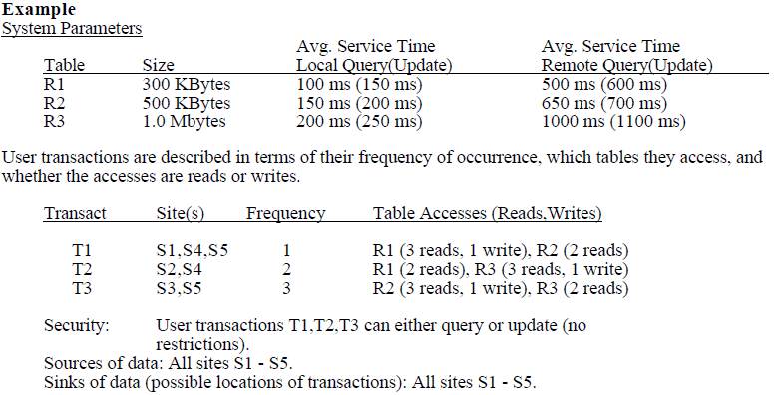
The Non-Redundant “Best Fit” Method
A general rule for data allocation states that data should be placed as close as possible to where it will be used, and then load balancing should be considered to find a global optimization of system performance.
The non-redundant “best fit” method determines the single most likely site to allocate a table based on maximum benefit, where benefit is interpreted to mean total query and update references. In particular, place table Ri at the site s* where the number of local query and update references by all the user transactions are maximized.

Slide 47
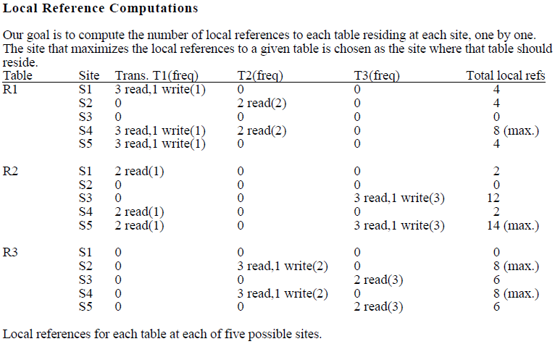

Slide 48
Allocation Decision
Allocate R1 at site S4.
Allocate R2 at site S5.
Allocate R3 at either site S2 or S4
Additional information is needed to choose this allocation. For instance, if maximum availability of data is a major consideration, then choose site S2 because site S4 already has table R1 allocated to it and putting R3 there as well would decrease the potential availability of data should site S4 crash.
Advantages
- simple algorithm
Disadvantages
- number of local references may not accurately characterize time or cost (reads and writes given equal weights)
- no insights regarding replication

Slide 49
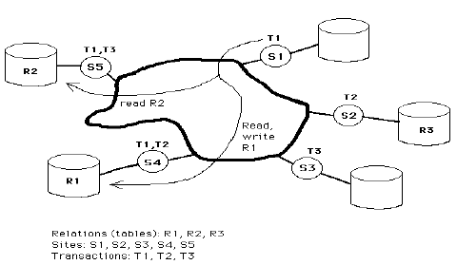

Slide 50
The Redundant “All Beneficial Sites” Method
This method can be used for either the redundant or non-redundant case. It selects all sites for a table allocation where the benefit is greater than the cost for one additional copy of that table. You are assumed to start with zero copies.
The benefit for table R at site S is measured by the difference in elapsed time to do a remote query to table R from site S (i.e. no replicated copy available locally) and a local query to table R at site S (i.e. replicated copy available locally). Total benefit for table R at site S is the weighted sum of benefit for each query times the frequency of queries.
The cost for table R at site S is the total elapsed time for all the local updates of table R, plus the total elapsed time for all the remote updates for the given table at that site. Total cost for table R at site S is weighted sum of cost for each update transaction times the frequency of update transactions.

Slide 51
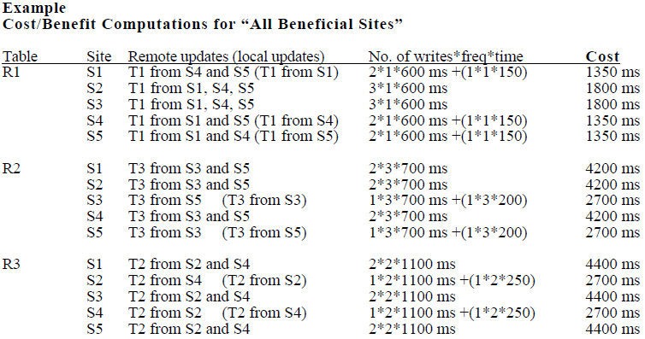

Slide 52
